Slide 1
CSJ ABSO FY19 Budget Request
February 24, 2018

Slide 2
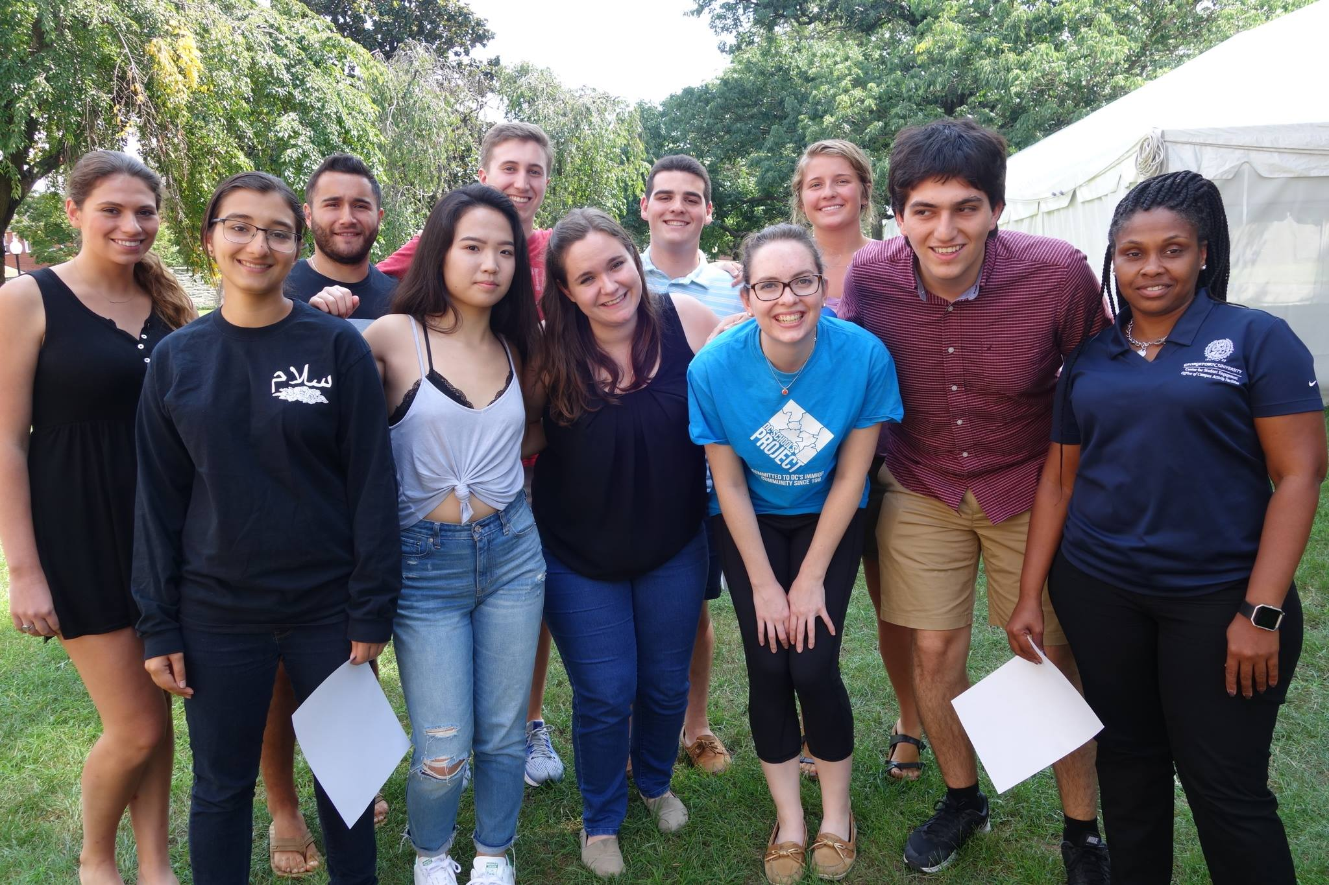
Our year as a board...
New training/retreat process
Recommitment to CSJ mission
Expansion of programming
New groups
Support of student programming and increased resources for student leaders
Increased accessibility/affordability of programming

Slide 3
Request for FY19
Total Request for FY19 | $185,750.00
New Clubs | $12,000.00
FY18 Allocation | $173,750.00

Slide 4
New Club Funding
8 New Groups either successfully completed NCD this fall or are in NCD as of this semester:
Heroes for Hearts
Special Olympics
Georgetown Make-A-Wish
Georgetown Ballers
Georgetown Dance Marathon
DCode
College Next Door
DC Leadership Workshop*
An average NCD group when it gains access to benefits submits a budget request of approximately $1,500

Slide 5
FY18 Allocations
FY18 GUSA FinApp allocation: $173,750.00
Student Affairs: $61,732.00
Coke Grant: $7,447.14
ABSO Reserve funds leveraging: $7,500.00
ABSO Total funds (as of Fall 2017): $250,429.14
FY18 Requested Amount: $303,655.28
FY18 Allocated Amount: $238,517.55
Overall cut budgets to ensure quality and mission-orientation of programming and that requests were within policy.

Slide 6
Unexpected Surplus
CSJ ABSO Unexpected Surplus: $36,126.00
Where did this money come from?
Groups that folded
International travel scholarships
Unspent funds which rolled over from the previous year
Where is this money going to?
Expanded service/social justice programming
Ensuring accessibility of CSJ ABSO programs
Social justice events targeting student groups
We are on track to spend our allocations from last year + this surplus during this fiscal year
Notes:
ABP scholarships (18,500.00) (10,000 from fall budget weekend and 8,500 this semester)
Careers for Common Good ($2,500): networking opportunity for undergraduate students to engage with GU alumni who are working in the field of social justice
Native American Student Council's Pow wow ($1,000)

Slide 7
CSJ ABSO YTD Spending
Year to date: $87,622.34
Remaining balance: $218,192.51
Spring expenditures:
ABP (~$93,000, minus two trips)
Vans ($30,000)
Relay for Life (~$9,000)
NASC Pow Wow (~$5,000)
Additional allocations:
ABP Scholarships ($8,500)
Careers for the Common Good ($2,500)
Regular spring programming (fall programming, minus vans): $57,622.34
Estimated total expenditure: $205,622.34 + ad hoc allocations

Slide 8
Request for FY19
Total Request for FY19 | $185,750.00
New Clubs | $12,000.00
FY18 Allocation | $173,750.00

Slide 9

CSJ ABSO is committed to advancing social justice on the Hilltop and beyond.

